Slide 1
RESPONSE TO THE GREEN ECONOMY IMPERATIVE FOR AFRICA IN THE 21ST CENTURY
A PLENARY SESSION
by
Prof. Hilary I. Inyang, NNOM
US Ambassador’s Distinguished Scholar to Ethiopia with a base at Bahir Dar University, Bahir Dar, Ethiopia.
h.inyang26@gmail.com
at
the
GLOBAL AFRICA DIASPORA SYMPOSIUM (GADS)
hosted
by
The Nigerians in Diaspora Commission (NiDCOM)
The Federal Republic of Nigeria,
Abuja, Nigeria.
DATE: APRIL 27-28, 2023

Slide 2
SIGNIFICANCE OF GREEN ECONOMY INTERVENTIONS IN AFRICA
On July 15, 2021, the African Union Commission (AUC) launched a 5-year Continental Green Recovery Action Plan 2021-2027.
The African Development Bank (AfDB) (Undated) estimates that with proper capacity building, the private sector can exploit 75% of about US $3 trillion investment opportunities that climate change will generate in Africa by 2030.
The World Meteorological Organization (2021) as reported in Africa Report (2021), estimates that African countries are spending 2-9% of their GDP on climate change adaptation and mitigation.

Slide 3
SECTORS IDENTIFIED BY UNEP (2011) AS KEY
TO GREENING THE ECONOMY
SECTORS OF GREEN ECONOMY TO ADDRESS
AGRICULTURAL PRACTICES AND FORESTRY
BUILDING MATERIALS
ENERGY SUPPLY
FISHERIES
ENERGY EFFICIENCY IN INDUSTRY
TOURISM
WASTE MANAGEMENT
WATER SYSTEMS
80% of Africa’s employment derives from agriculture, mineral exploitation, fishing and forestry (UNESEC, 2011)

Slide 4
SECTION a
INTRODUCTION: DEFINING GREEN ECONOMY AND ITS SIGNIFICANCE

Slide 5
DEFINING GREEN ECONOMY
KEY POINTS TO NOTE
UNEP’S DEFINITION OF GREEN ECONOMY
“An economy that results in improved well-being and social equity, while significantly reducing environmental risks and ecological scarcities”
CHARACTERISTICS OF GREEN ECONOMIES
    Low-carbon development
    Enhanced efficiency
    Social equity/inclusiveness

Slide 6
KEY AXIOMS AND RATIONALIZATION OF GREEN ECONOMY (1)
Green Economy initiatives accelerate movement toward sustainable development.
Environmental sustainability is not the antithesis of economic progress.
Observed 400% increase in global economy with 60% degradation of major ecosystem goods and services over the past 100 years (World Economic Database, 2006)
Identification of carbon-powered industrialization and other anthropogenic activities as the major causes of current and potential environmental degradation.

Slide 7
KEY AXIOMS AND RATIONALIZATION OF GREEN ECONOMY (2)
Technological innovations have made it possible, and in some cases, cost-effective to transform economies from brown to green.
Comparative studies that show 2% addition allocation to greening economy for 50 years would make substantive gains over business as usual (BAU).
Africa’s low industrialization level provides an opportunity to escape the lock-in to brown economy in the emerging 4th Industrial Revolution (4IR).

Slide 8
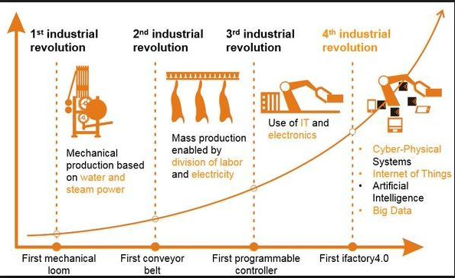
GREEN ECONOMY IS TARGETED BY MOST COUNTRIES EVEN AS THE 4TH INDUSTRIAL REVOLUTION UNFOLDS
SOURCE: ottomotors.com/blog/industry-4-0-connected-factory

Slide 9
THE SUSTAINABLE DEVELOPMENT CONTEXT
(Inyang, 2016)

Slide 10
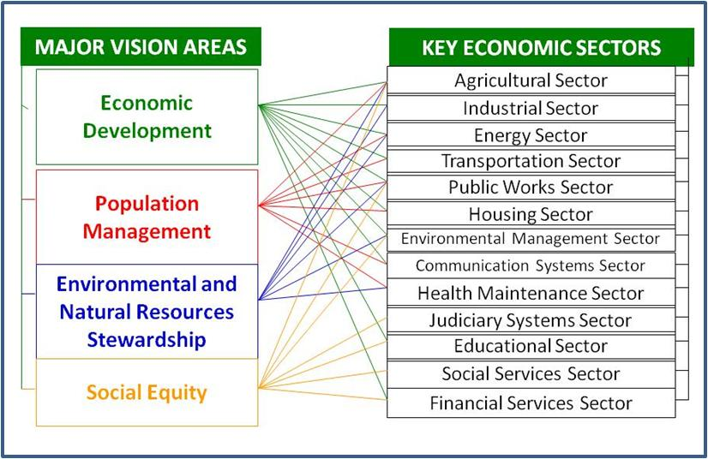
GREEN ECONOMY AND SUSTAINABLE DEVELOPMENT NEED TO PERCOLATE THROUGH ALL SOCIOECONOMIC SECTORS
(Inyang, 2016)

Slide 11
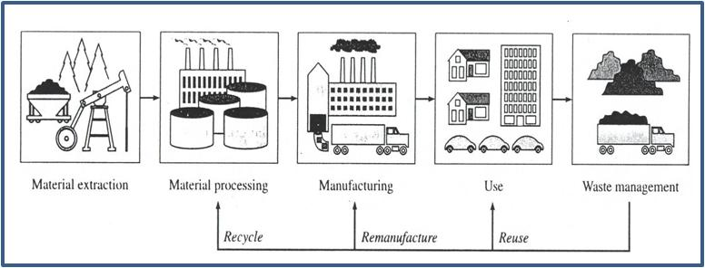
NATURAL RESOURCE EXTRACTION, PROCESSING AND MANUFACTURING PROCESSES HAS SUPPORTED ECONOMIC DEVELOPMENT BUT HAS GENERATED WASTES AND ECOLOGICAL CHALLENGES AT VARIOUS STAGES: GREEN ECONOMY SHOULD PROMOTE RECYCLING, REMANUFACTURING AND REUSE (RRR) AND WASTE MANAGEMENT LOOPS

Slide 12
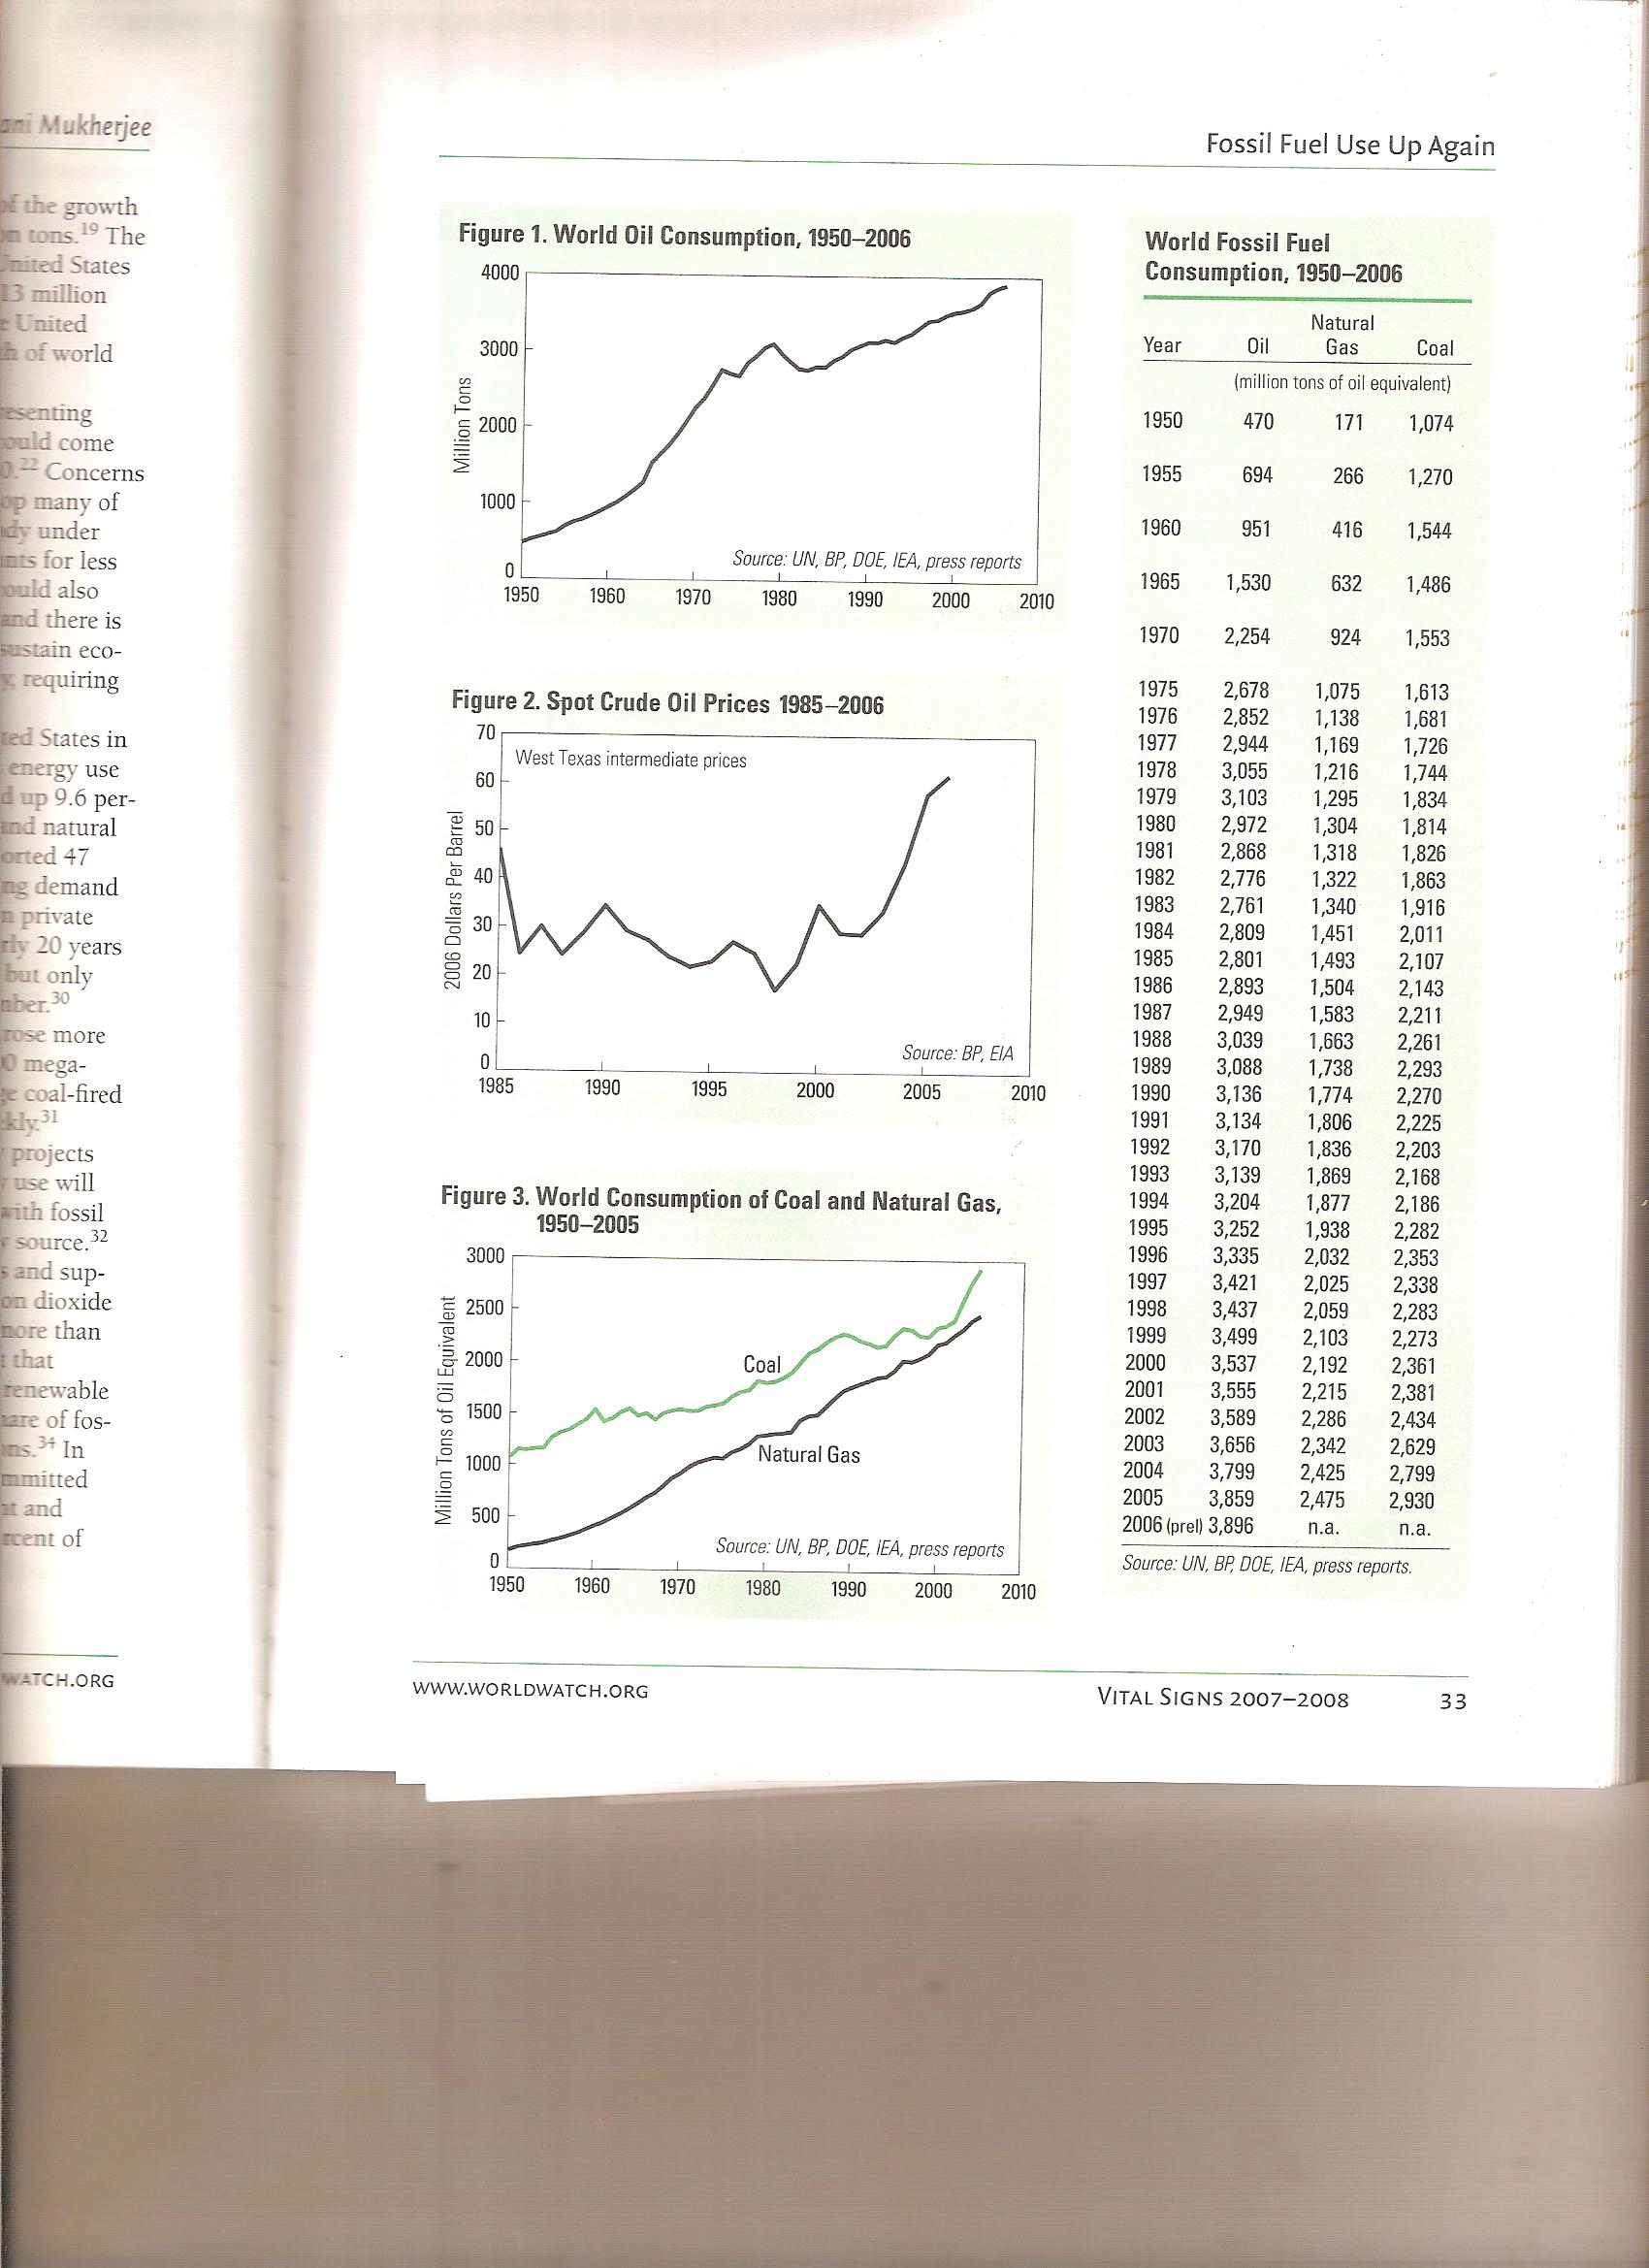
COAL HAS SERVED FOR CENTURIES, AS THE SOURCE OF ENERGY FOR SOCIETAL DEVELOPMENT BUT THEY HAVE ALSO BEEN INCREASE IN THE USE OF OTHER FORMS OF CARBON-BASED ENERGY SUCH AS OIL AND GAS
Source: WWW.WORLDWATCH.ORG

Slide 13
SECTION b
ECONOMIC DEVELOPMENT AS THE GENERATOR OF ENVIRONMENTAL POLLUTION AND ASSOCIATED SOCIAL CONFLICTS

Slide 14
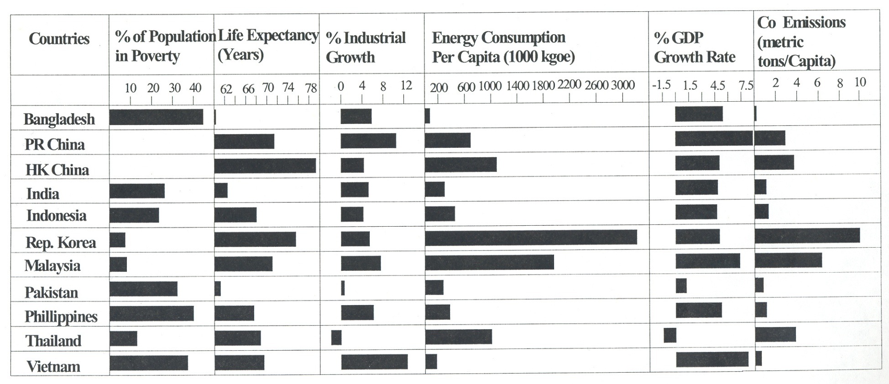
HOWEVER, ENERGY PRODUCTION AND USE, AND MATERIAL INVESTMENTS IN ECONOMIC DEVELOPMENT HAVE BOTH POSITIVE AND NEGATIVE IMPACTS
THE POLLUTION BYPRODUCT OF ENERGY-INTENSIVE DEVELOPMENT OF THE “ASIA TIGER” COUNTRIES (2002)
INYANG, H. I (2002) LECTURE

Slide 15
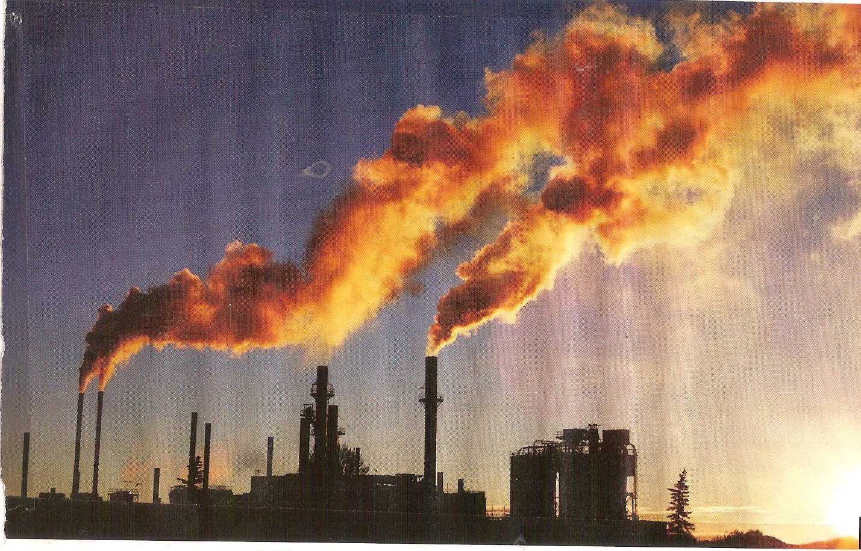
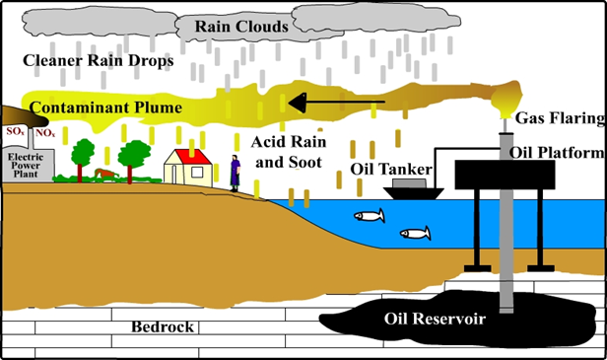
AIR POLLUTION (1)
Dust emissions Industrial stack emissions Acid rain | Chemical vapors Noise pollution and control Ozone depletion
Air pollutant emissions from factories
Depiction of air pollutant emissions from oil platforms through gas flaring (Inyang, 2010)

Slide 16
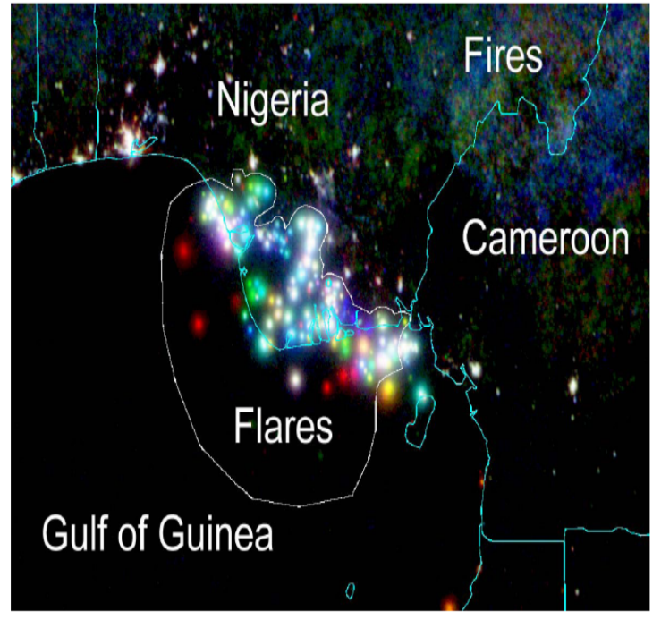
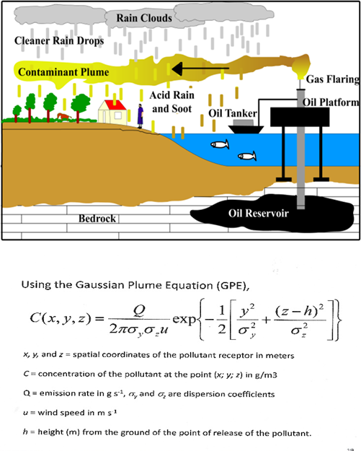
NIGHT-TIME SATELLITE PICTURES HAVE SHOWN THE INTENSITY OF GAS FLARING IN THE NIGER DELTA OF NIGERIA
AIR POLLUTION (2)
DEPICTION OF GAS FLARING IN THE NIGER DELTA OF NIGERIA WHICH IS PARTLY RESPONSIBLE FOR ACID RAIN (Inyang)
(Color Composite of Nighttime Gas Flares in The Coastal Region of Nigeria (1992 In Blue, 2000 In Green And 2006 In Red) (NASA)

Slide 17
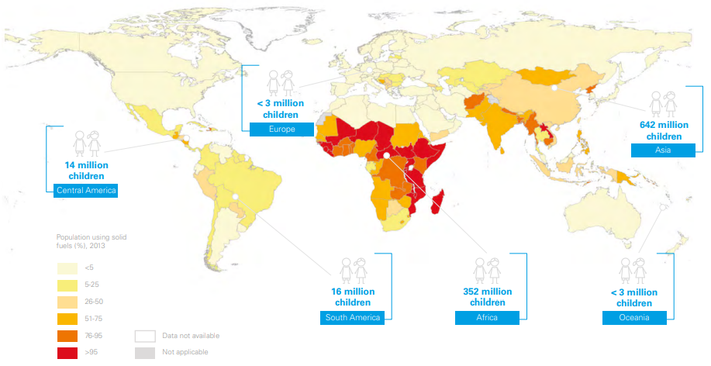
OVER 1 BILLION CHILDREN LIVE IN HOMES WHERE SOLID FUELS ARE USED IN COOKING AND HEATING
(POPULATION USING SOLID FUELS (%), 2013)
Data Source: World Health Organization Global Health Observatory Data Repository Map Production: Health Statistics and Information Systems (HSI),Global Health Observatory 2014.

Slide 18
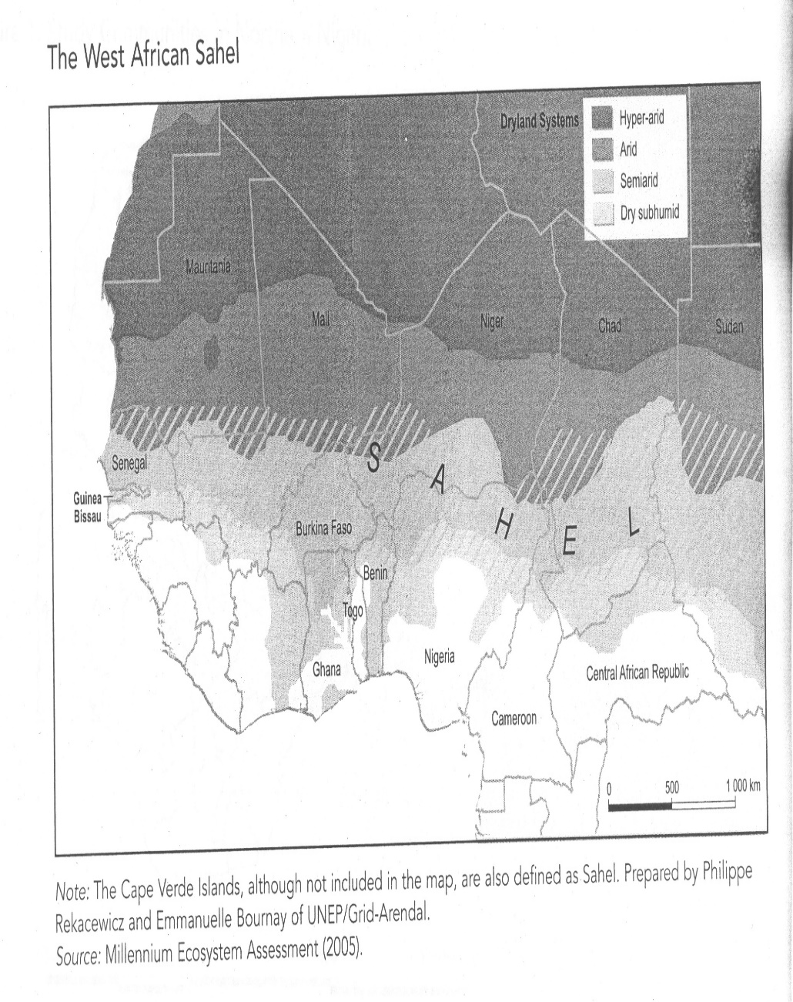
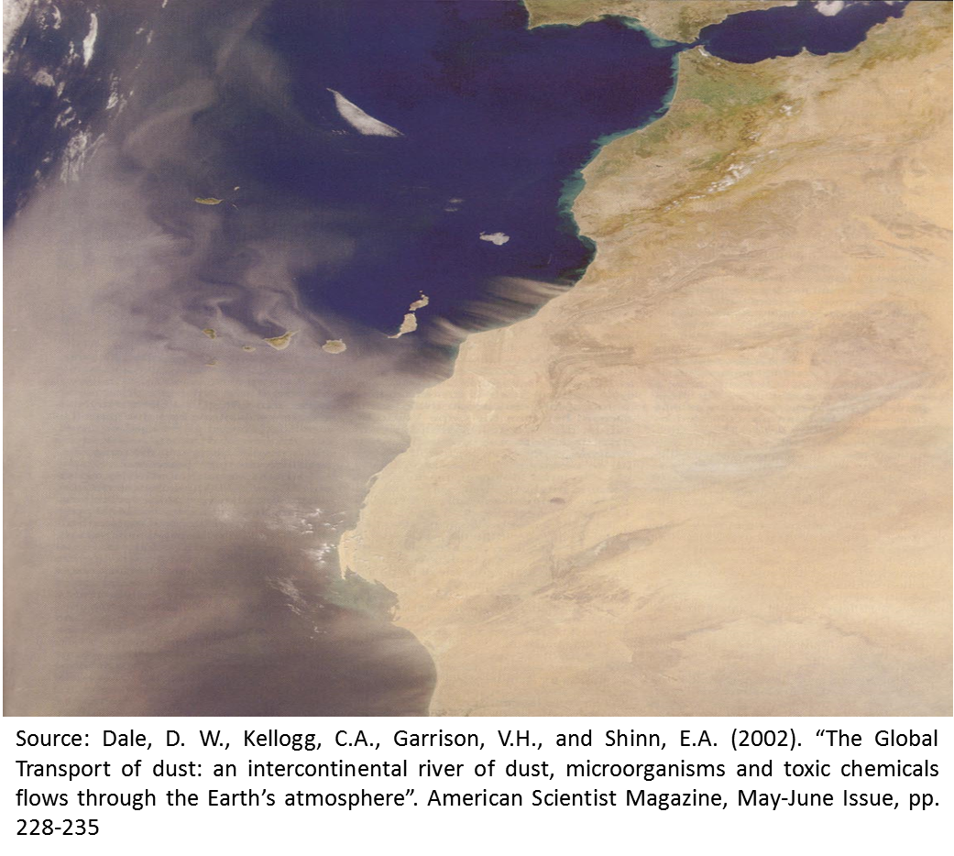
ECOLOGICAL SYSTEM IMPACTS
DESERTIFICATION AND DROUGHTS
THE WEST AFRICAN SAHEL: WILL EXPAND SOUTHWARDS AS THE DESERTIFICATION GROWS AS AN IMPACT OF GLOBAL CLIMATE CHANGE. ABUJA MAY BE MARGINALLY AFFECTED BY DRY SPELLS. | THE IMPACTS ARE NOT ONLY REGIONAL BUT GLOBAL AS THE INTERNATIONAL TRANSFER OF AIRBORNE SOIL PARTICLES CAUSES ECOLOGICAL PROBLEMS IN MANY COUNTRIES (GIANT DUST STORM ABOVE NORTHWESTERN AFRICA BLOWS OUT INTO THE ATLANTIC OVER THE CANARY ISLANDS ON FEBRUARY 11, 2001)

Slide 19
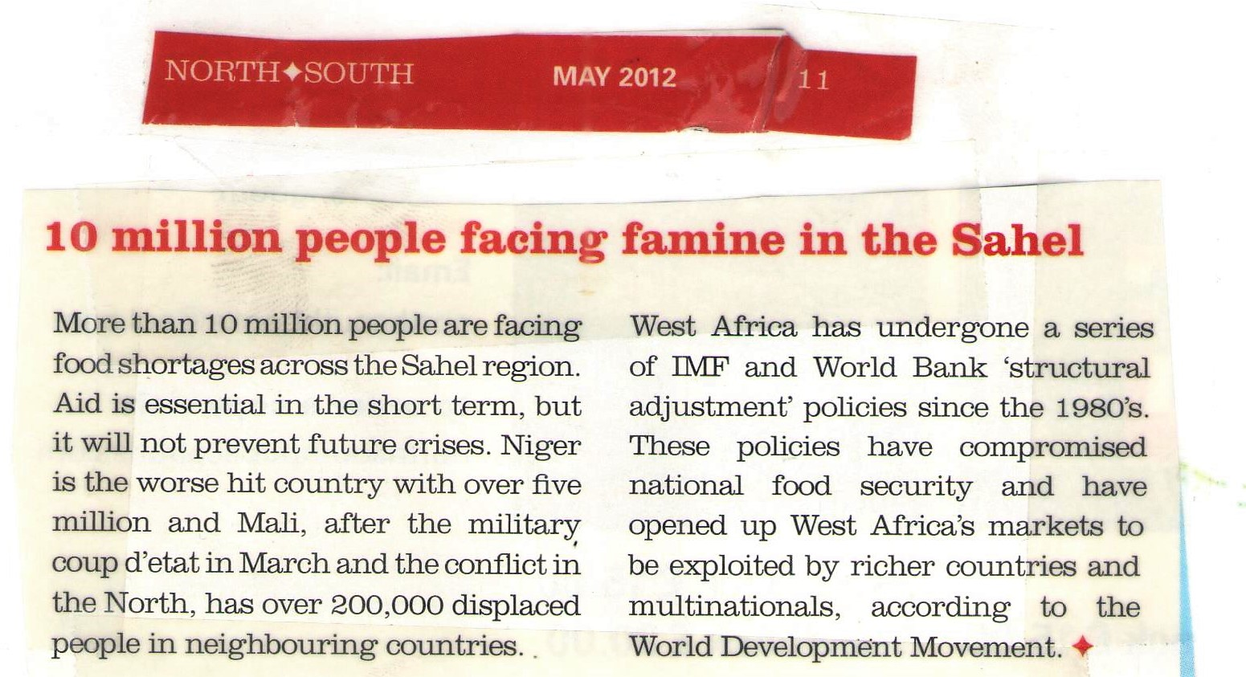
CLIMATE CHANGE IMPACTS ON AGRICULTURE AND FOOD SECURITY

Slide 20
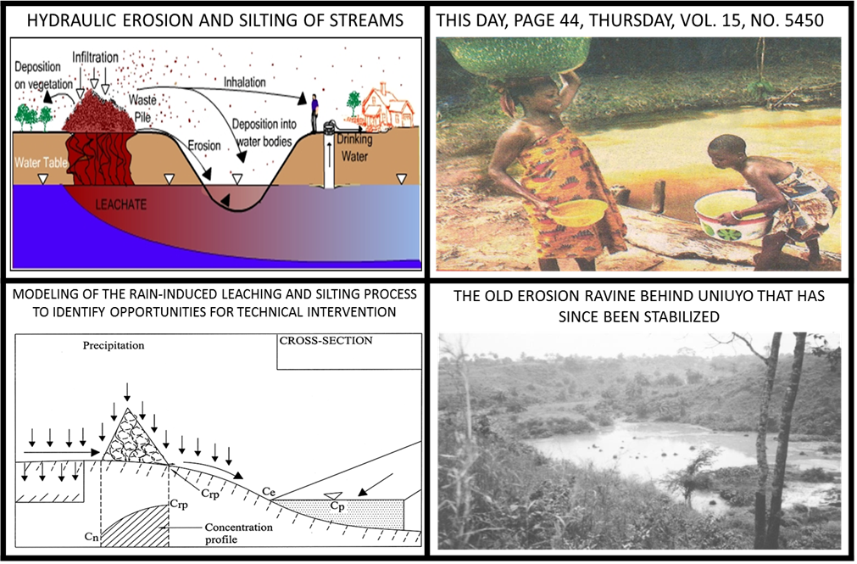
SURFACE WATER QUALITY DEGRADATION BY EXCESSIVE PRECIPITATION AND RUNOFF WITH EXCESSIVE EROSION IN SOME AFRICAN LOCALITIES

Slide 21
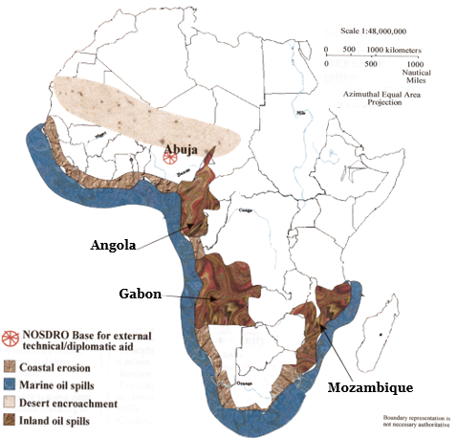
COASTAL COUNTRIES IN WEST, SOUTHERN AND EAST AFRICA HAVE COASTAL MARINE OIL POLLUTION PROBLEMS (INYANG, 2010)
21

Slide 22
A BRIEF SAMPLING OF MARINE OIL SPILL CASES AROUND THE COAST OF SOUTH AFRICA
30% of all oil exports from the Near-East traverse the Western Indian Ocean with many cases of oil spills (GMOPIG, 2022).
    8000 ocean-going vessels round the Capes annually including about 2500 tankers carry about 600 million tonnes of oil from the Middle East to Europe and the Americas (Chapman and Watling, 1980).
    In 1994, MV Apollo Sea, a tanker sanded off Cape Town and spilled fuel on beaches (Swanepoel, E., 2022).
    In 2000, MV Treasure sank and spilled 200 tonnes of heavy fuel oil that devastated African penguin populations around South Africa (Swanepoel, E., 2022).

Slide 23
A BRIEF SAMPLING OF MARINE OIL SPILL CASES AROUND THE COAST OF NIGERIA
Oil constitutes about 25% of Nigeria’s GDP, 95% of her annual foreign revenue, and 65% of annual budgetary projections but there are environmental pollution incidents and risks.
    Nigeria has about 30 offshore oil fields, 620 deep-water and offshore oil wells, and numerous onshore facilities.
    In 1978, the Excravos Export Terminal Equipment Failure spilled about 300,000 barrels of oil into the Atlantic and damaged the coastal environment (Ogbuka et al, 2022).
    In 2011, Shell Nigeria Petroleum Company well blowout in offshore Bonga outfield damaged coastal waters and settlements with about 40,000 barrels of oil (Ogbuka et al, 2022).

Slide 24
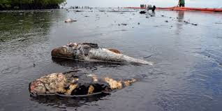
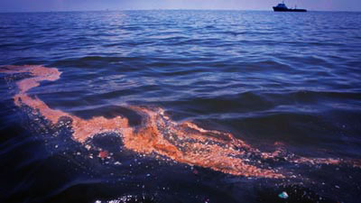
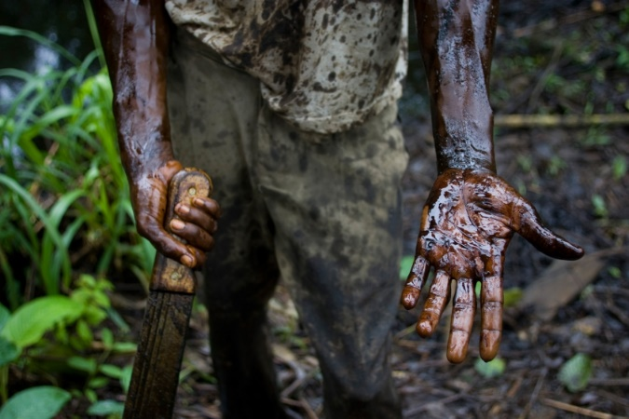
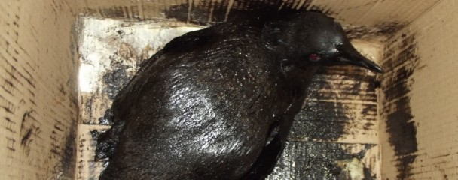
RESOURCE DAMAGES, OCCUPATIONAL LOSSES, POLLUTION AND COMMUNAL CONFLICT FACTORS HAVE CONTINUED TO THREATEN ECOLOGICAL SAFETY OF COASTAL MARINE AREAS OF AFRICA (A AND B IN NIGERIA; AND C AND D IN SOUTH AFRICA)
A. Oil spillages and fish mortality due to spreading of contaminant resulting from climate change will diminish fishing as an occupation | C. Oil spill near Robben Island affects penguins (South Africa) | Posted by: The ocean update | September 3, 2012 (SABC)
B. Threats to farming by land losses (due to erosion and submergence) and pollution will increase in the Niger Delta | D. Oil Spills in South Africa. By Jane | Ocean Adventure (December 2, 2014) | (https://oceanadventures.co.za/oil-spills-south-africa/)
Source: maryelikafoundation death of biodiversity.
Source: greennigeria.wordpress.com
Source: inhabitat.com

Slide 25
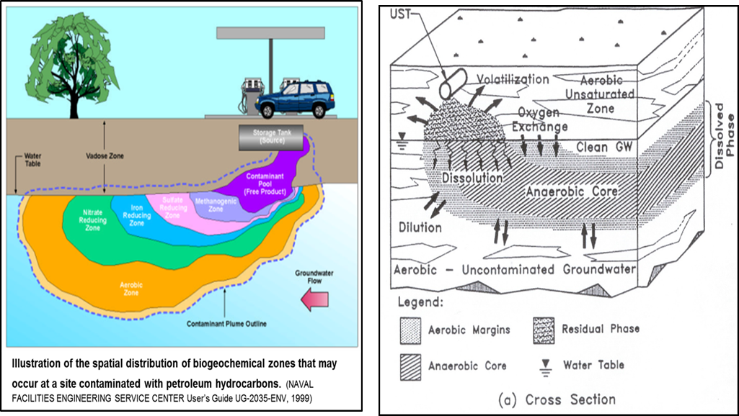
THOUSANDS OF BURIED UNDERGROUND TANKS FOR PETROL ARE POSSIBLY LEAKING ALL OVER AFRICAN MUNICIPALITIES AND MAY CONTAMINATE BOREHOLE WATER WITH KNOWN IMPACTS ON HUMAN HEALTH WITHOUT MONITORING AND MITIGATIVE ACTIONS
DEPICTION OF PETROLEUM PRODUCTS FATE AND TRANSPORT PROCESSES IN THE SUBSURFACE: SOME PROCESSES WILL BE ENHANCED BY HIGHER SOIL TEMPERATURE AND ELEVATION OF THE WATER TABLE IN NIGERIA DURING WET SEASONS
25

Slide 26
SECTION c
HUMAN HEALTH IMPACTS OF ENVIRONMENTAL POLLUTION AND CLIMATE CHANGE IN AFRICA

Slide 27
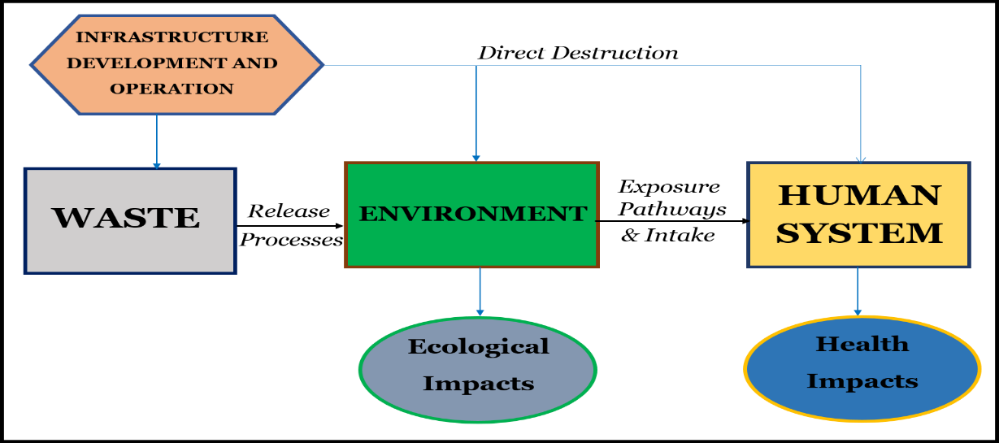
THE RELATIONSHIP BETWEEN INFRASTRUCTURE DEVELOPMENT/OPERATION AND THEIR IMPACTS ON THE ENVIRONMENT AND HUMAN HEALTH

Slide 28
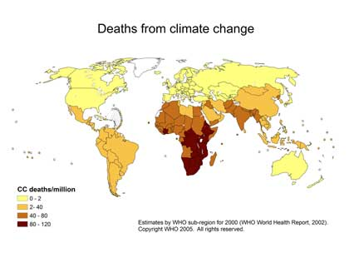
HUMAN MORTALITY IMPACTS OF GLOBAL CLIMATE CHANGE DEATHS THAT CAN BE ATTRIBUTED TO CLIMATE CHANGE IN VARIOUS COUNTRIES

Slide 29
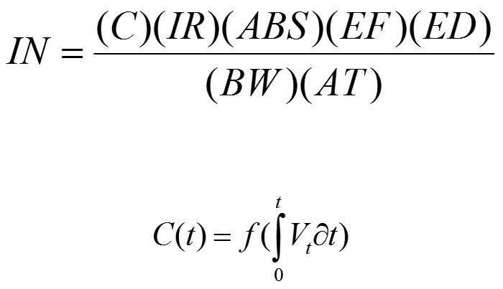
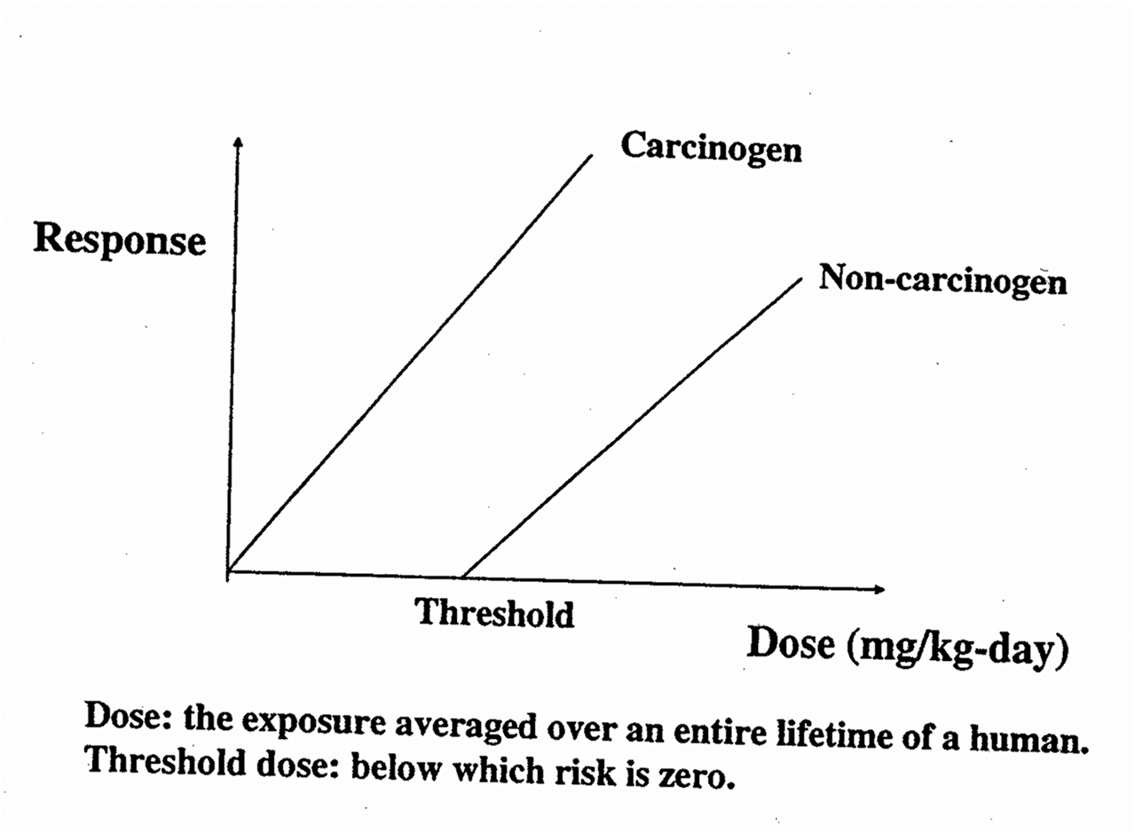
HEALTH IMPACTS OF GLOBAL CLIMATE CHANGE
HUMAN INTAKE OF CONTAMINANTS THAT WILL BE MADE MORE ACCESSIBLE BY GLOBAL CLIMATE CHANGE
THERE ARE DIRECT QUANTITATIVE RELATIONSHIPS BETWEEN CONTAMINANT CONCENTRATION IN AIR, SOIL & WATER AND HUMAN INTAKE, WITH POTENTIAL HEALTH EFFECTS
THE BASIC EQUATION OF HUMAN EXPOSURE ASSESSMENT THAT CAN BE USED TO DETERMINE HOW MUCH CONTAMINATE IS TAKEN IN BY AN INDIVIDUAL WHO IS EXPOSED TO IT OVER A GIVEN TIME INTERVAL | SOME CONTAMINANTS TAKEN IN BY RESIDENTS BY POLLUTED AREAS REQUIRE THRESHOLD DOSES FOR MANIFESTATION OF DISEASES JUST BECAUSE IT HAS NOT HAPPENED YET DOES NOT MEAN IT WILL NOT HAPPEN IN THE FUTURE
IN = the intake defined as the amount of a specific chemical in a contaminated medium taken (mg/kg of body weight per day).
C = the average chemical concentration contacted over the exposure period (mg/L for liquid and gases, and mg/mg for solids);
IR = the intake rate defined as the amount of the contaminated medium contacted per unit of time or event (mg/day or L/day)
ABS = fraction of contaminants that are absorbed
EF = the upper-bound value of the exposure frequency (day/year)
ED = the upper-bound value of the exposure duration (years)
BW = the average body weight over the exposure period (kg)
AT = the average time period over which exposure is averaged (exposure duration for non-carcinogens and 70 years for carcinogens)
V_{t} = the volume of contaminant released at the performance time frame of interest, t

Slide 30
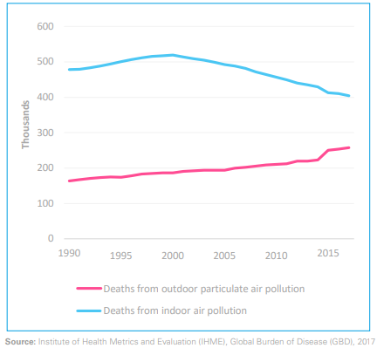
AIR POLLUTION AS THE MOST DAMAGING ENVIRONMENTAL HAZARD WITH RESPECT TO HUMAN MORTALITY AND HEALTH
ABSOLUTE NUMBER OF DEATHS ATTRIBUTED TO AMBIENT (OUTDOOR) AIR POLLUTION, AND TO HOUSEHOLD POLLUTION FROM COOKING AND HEATING (1990-2017)

Slide 31
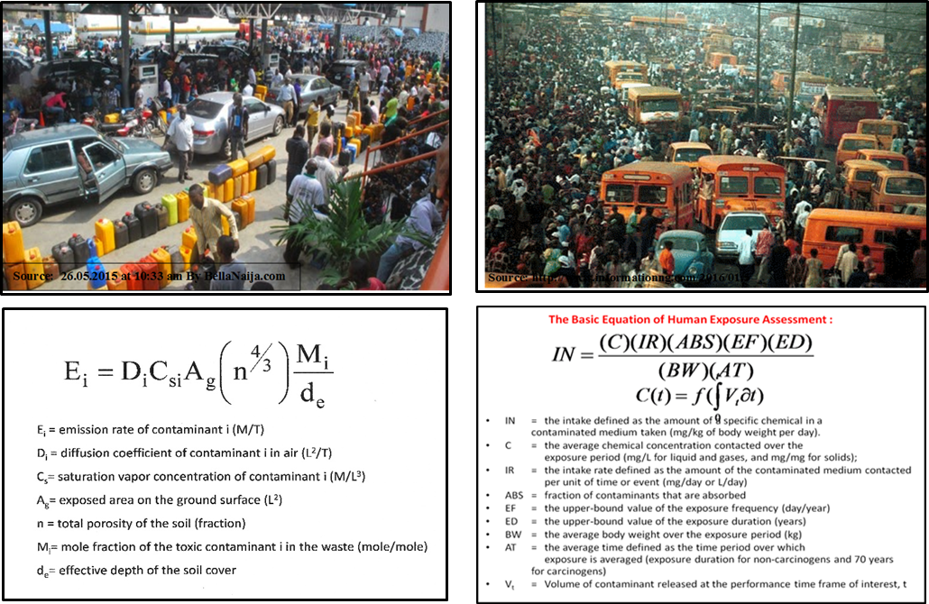
MASS EXPOSURE OF PEOPLE TO HYDROCARBON FUMES DURING QUEUES AT PETROL STATIONS IN AFRICA IS DAMAGING TO HUMAN HEALTH
TRAFFIC JAMS IN MANY AFRICAN CITIES EXEMPLIFIED BY THE SITUATION IN LAGOS, ENABLES EXPOSURE OF THOUSANDS OF PEOPLE TO AUTO EMISSIONS DAILY

Slide 32
Potentially Harmful Components of Common (Household) Products IN MOST AFRICAN COUNTRIES, some of which may end up in DOMESTIC borehole water THAT IS CONSUMED (1)
PRODUCT | TOXIC OR HAZARDOUS COMPONENTS
Antifreeze (gasoline or coolant systems) | Methanol, ethylene glycol
Automatic transmission fluid | Petroleum distillates, xylene
Battery acid (electrolyte) | Sulfuric acid
Degreasers for driveways and garages | Petroleum solvents ,alcohols, glycol ether
Degreasers for engines and metal | Chlorinated hydrocarbons, toluene, phenols, dichloroperchloroethylene
Engine and radiator flushes | Petroleum solvents, ketones, butanol, glycol ether
Hydraulic fluid (brake fluid) | Hydrocarbons, fluorocarbons
Motor oils and waste oils | Hydrocarbons
Gasoline and jet fuels | Hydrocarbons
Diesel fuel, kerosene, #2 heating oil | Hydrocarbons
Grease, lubes | Hydrocarbons
Rustproofers | Phenols, heavy metals
Car wash detergents | Alkyl benzene sulfonates
Car waxes and polishes | Petroleum distillates, hydrocarbons
Asphalt and roofing tar | Hydrocarbons
Paints, varnishes, stains and dyes | Heavy metals, toluene
Paint and lacquer thinner | Acetone, benzene, toluene, butyl acetate, methyl ketones
Paint and varnish removers, deglossers | Methylene chloride, toulene, acetone, xylene, ethanol, benzene, methanol

Slide 33
Potentially Harmful Components of Common (Household) Products IN MOST AFRICAN COUNTRIES, some of which may end up in DOMESTIC borehole water THAT IS CONSUMED (2)
PRODUCT | TOXIC OR HAZARDOUS COMPONENTS
Paint brush cleaners | Hydrocarbons, toulene, acetone, methanol, glycol ethers, methyl ethyl ketones
Floor and furniture strippers | Xylene
Metal polishes | Petroleum distillates, isopropanol, petroleum naptha
Laundry soil and stain removers | Hydrocarbons, benzene, trichloroethylene, 1,1,1-trichloroethane
Other solvents | Acetone, benzene
Rock salt | Sodium concentration
Refrigerants | 1,1,2-trichloro-1,2,2-trifluoroethane
Bug and tar removers | Xylene, petroleum distillates
Household cleansers, oven cleaners | Xylenols, glycol ethers, isopropanol
Drain cleaners | 1,1,1-trichloroethane
Toilet cleaners | Xylene, sulfonates, chlorinated phenols
Cesspool cleaners | Tetrachloroethylene, dichlorobenzene, methylene chloride
Disinfectants | Cresol, xylenols
Pesticides (all types) | Naphthalene, phosphorous, xylene, chloroform, heavy metals, chlorinated hydrocar
Photochemicals | Phenols, sodium sulfite, cyanide, silver halide, potassium bromide
Printing ink | Heavy metals, phenol-formaldehyde
Wood preservatives (creosote) | Pentachlorophenols
Swimming pool chlorine | Sodium hypochlorite
Lye or caustic soda | Sodium hydroxide

Slide 34
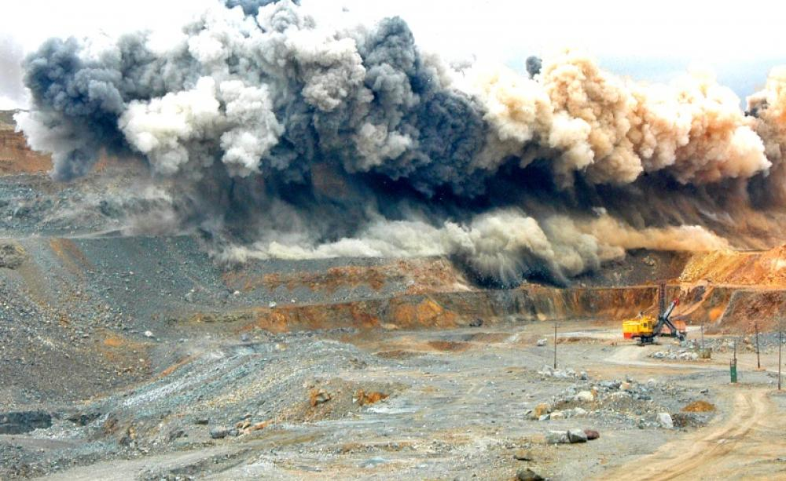
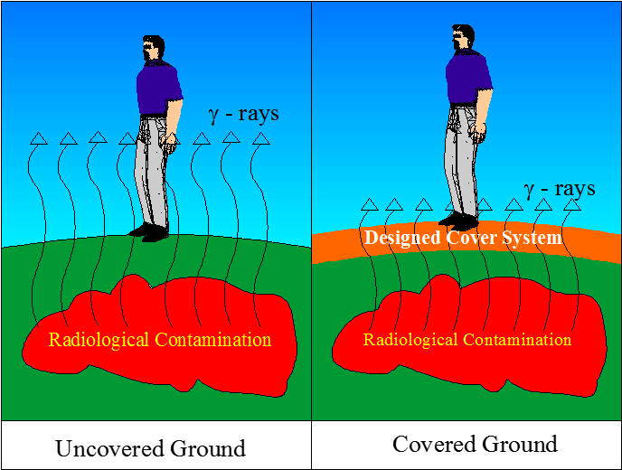
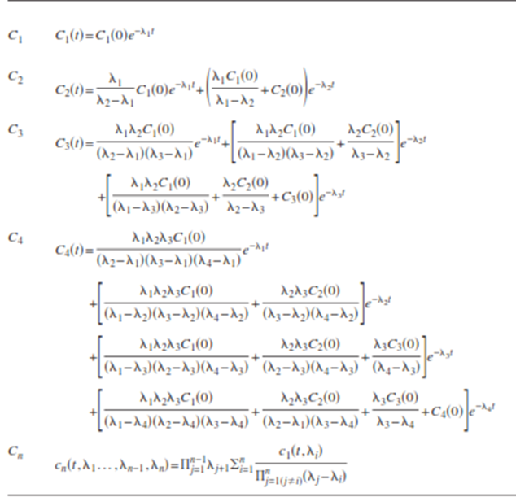
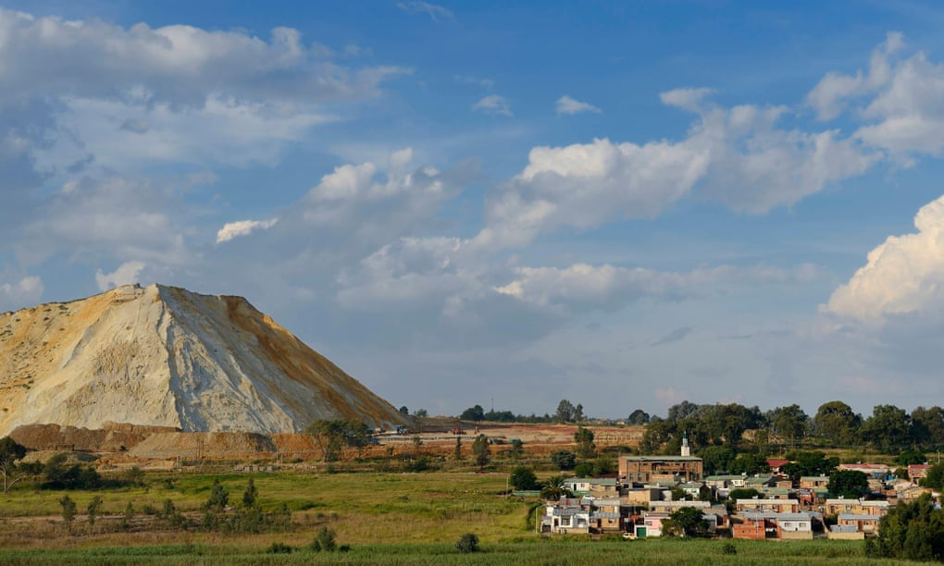
MINING WASTE PILES IN SOUTH AFRICA AND MANY MINERAL-RICH AFRICAN COUNTRIES CAN GENERATE HEALTH-DAMAGING GAMMA RADIATION THROUGH RADIOACTIVE DECAYS OF RADIOLOGICAL WASTES:
THIS PROBLEM HAVE NOT BEEN INVESTIGATED MUCH IN AFRICA
Drilling and blasting creates large volumes of radioactive dust. Photo: Andrey Serebryakov. (Dr Stefan Cramer (2016). Uranium mining threatens South Africa‘s iconic Karoo. Ecologist.
Johannesburg’s Soweto Riverlea neighbourhood in the shadow of a gold mine slag heap. Photograph: Alamy

Slide 35
SECTION d
FRAMING GREEN ECONOMY TO SUPPORT SUSTAINABLE DEVELOPMENT IN VARIOUS SECTORS

Slide 36
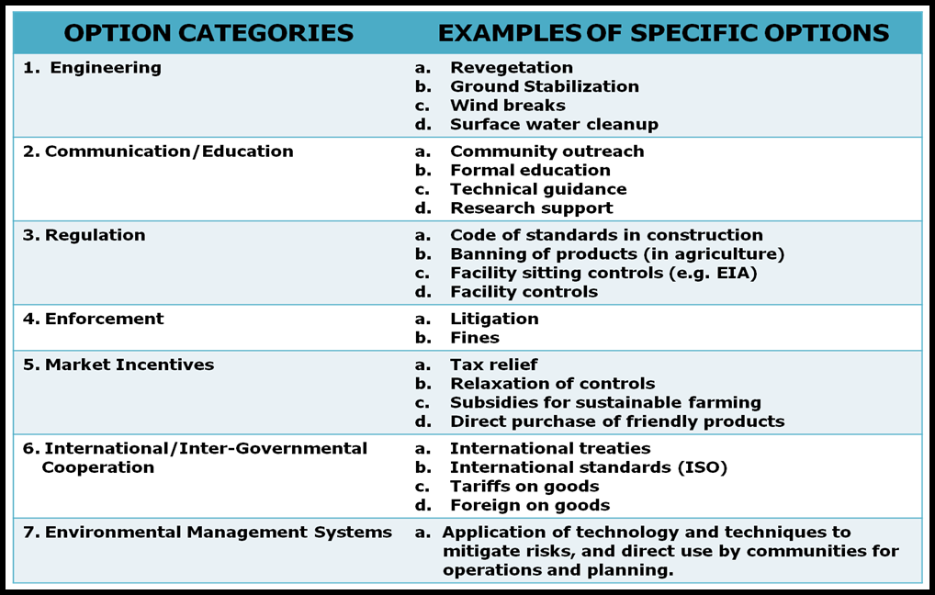
CATALOG OF OPTIONS FROM WHICH MEASURES CAN BE SELECTED, OPTIMIZED AND IMPLEMENTED TO ADAPT TO ENVIRONMENTAL DAMAGES
36

Slide 37
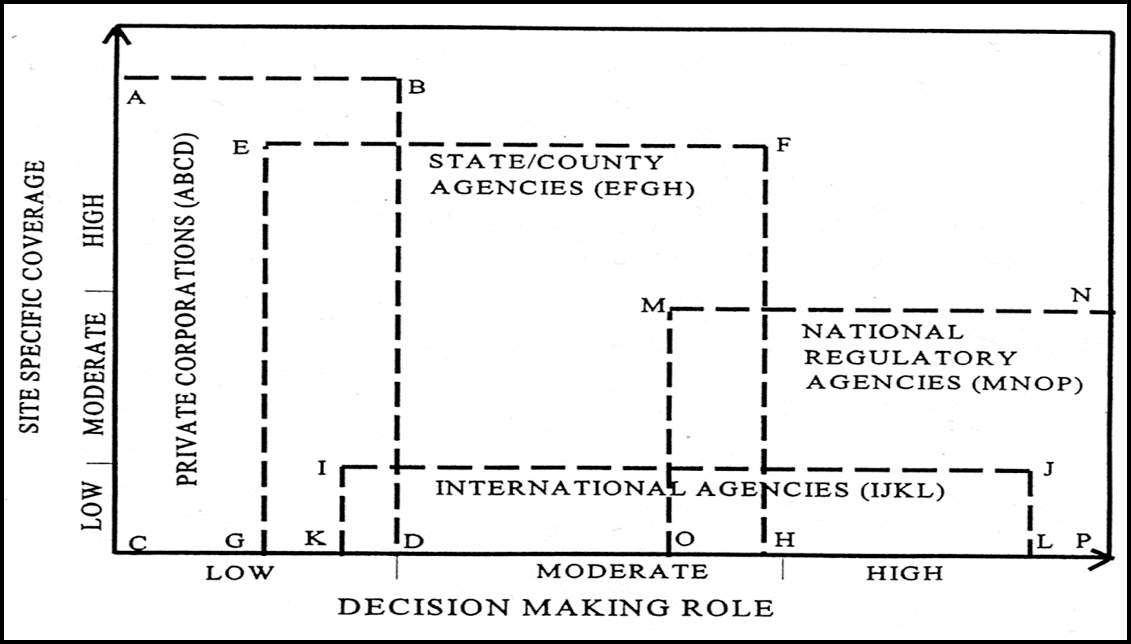
JURISDICTIONAL COVERAGE OF ROLES AND RESPONSIBILITIES ON IMPROVEMENT OF ENVIRONMENTAL SYSTEMS
37

Slide 38
APPROACHES TO ANALYSES OF PROJECT/PROGRAMME OPTIONS THAT AFRICAN MINISTRIES AND AGENCIES SHOULD USE IN SCREENING AND SELECTING DEVELOPMENT PROGRAMMES AND PROJECTS TO GREEN THEIR ECONOMIES
DUE TO DIFFICULTIES TO FULLY ANALYZING ALL IDENTIFIED PROSPECTIVE OPTIONS, IT IS USUALLY ADVISABLE TO INTRODUCE A SCREENING PROCESS TO ELIMINATE WEAK OPTIONS.
COMMON SCREENING FACTORS
Available Budget
Time to implement
Jurisdictional Authority
Legality
Green Rating
DETAILED EVALUATION FACTORS
Cost Analysis
Cost/Benefit Analysis
Risk/Benefit Analysis
Failure Analysis

Slide 39
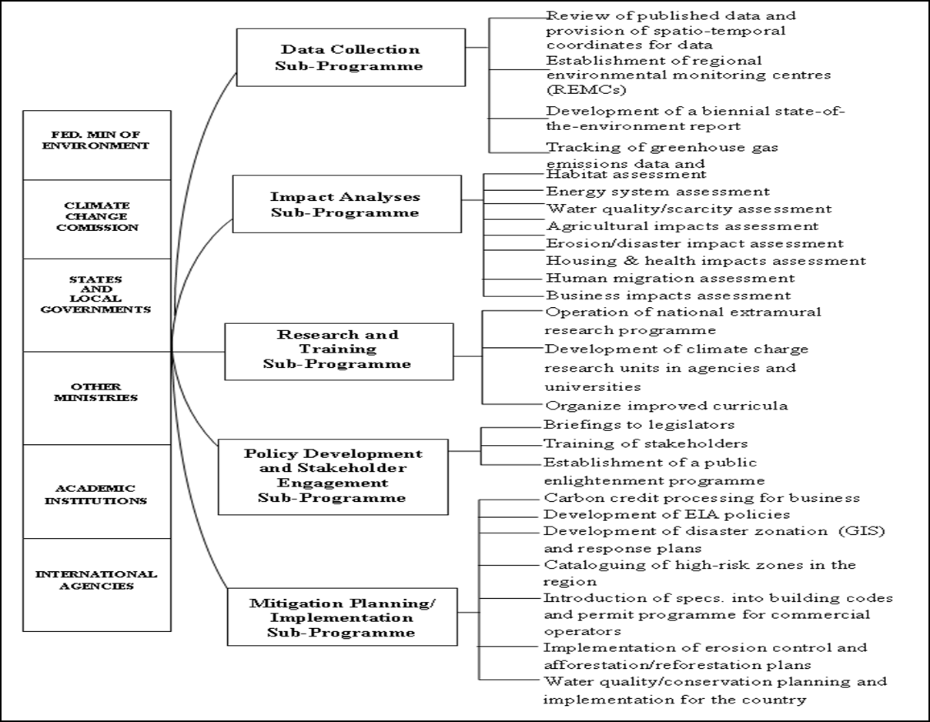
GLOBAL CLIMATE CHANGE PROGRAM DEVELOPMENT AND IMPLEMENTATION

Slide 40
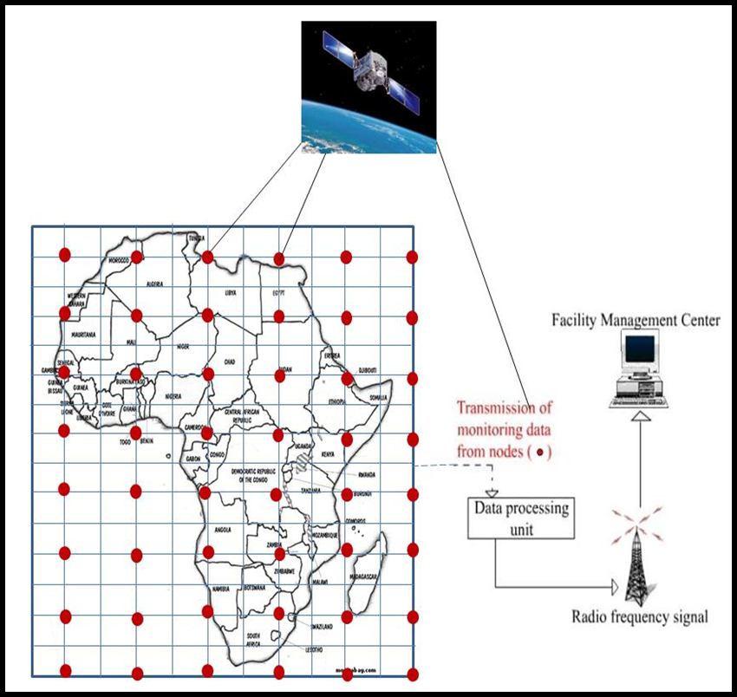
EXISTING DATA THAT ARE GIVEN VARIOUS SPATIO-TEMPORAL COORDINATES NEED TO BE INTERLINKED WITH MORE RECENT DATA THAT CAN BE GENERATED BY SATELLITES AND TRANSFERRED BY BOTH SATELLITE AND CABLE COMMUNICATION SYSTEMS

Slide 41
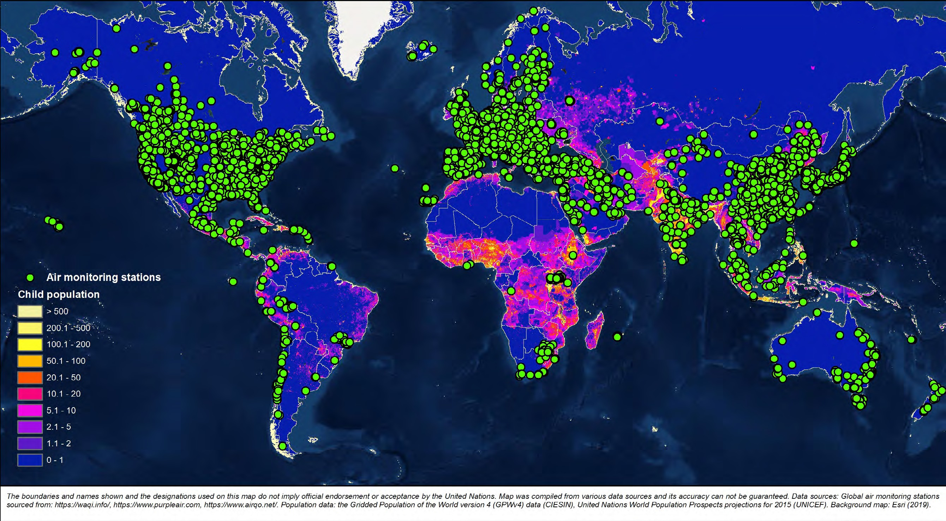
REAL-TIME AIR POLLUTION MONITORING STATIONS GLOBALLY
NOTE THE SPARSITY OF MONITORING STATIONS IN AFRICA

Slide 42
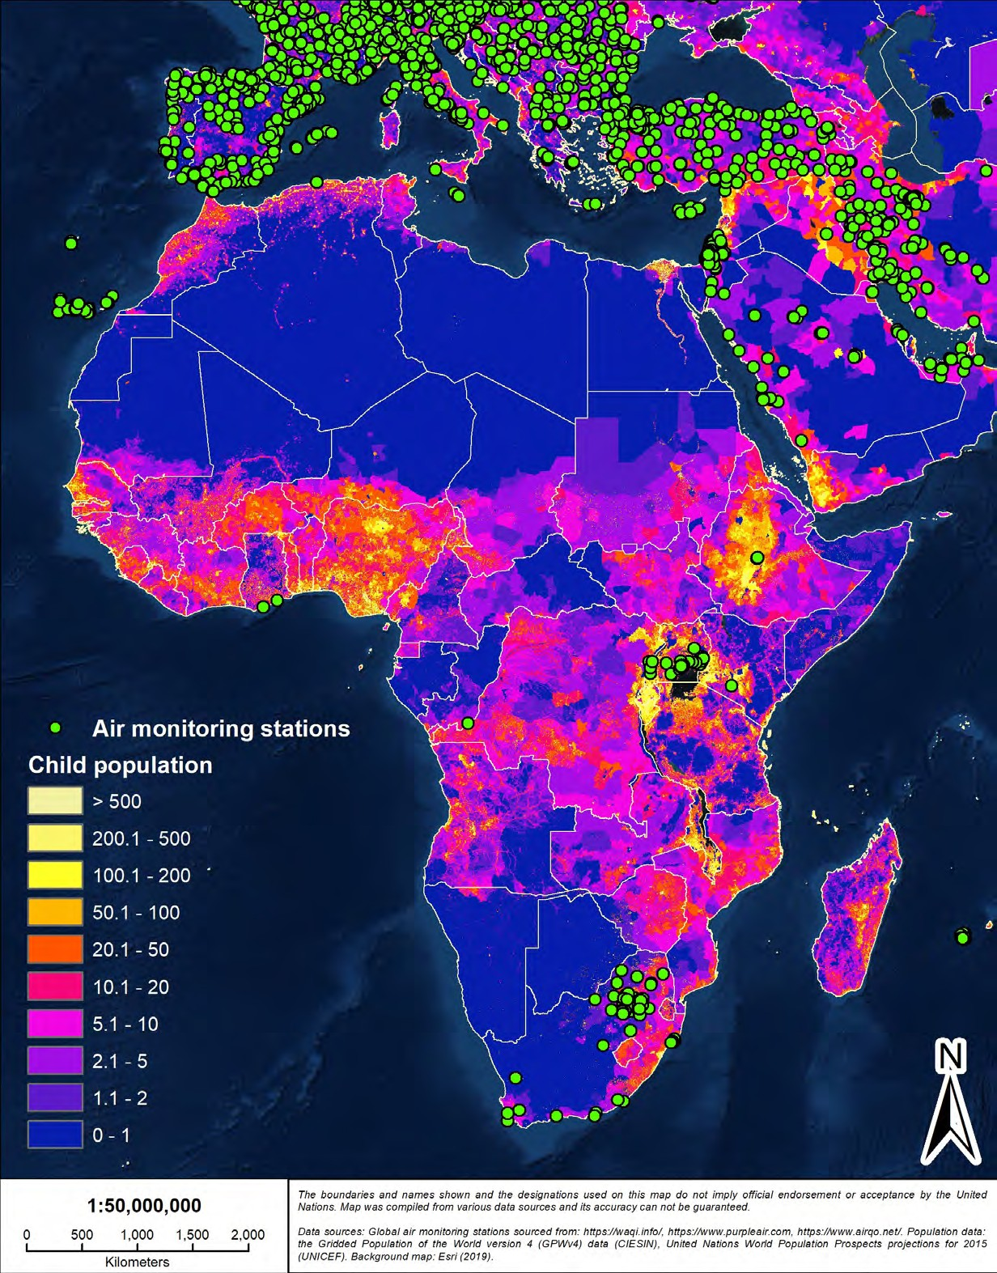
AIR POLLUTION MONITORING IN AFRICA

Slide 43
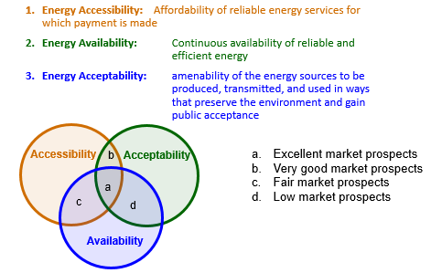
THE ENERGY SECTOR IS CRITICAL TO GREEN ECONOMY DEVELOPMENT AND A MAJOR SECTOR ON WHICH TO ENGAGE THE PRIVATE SECTOR

Slide 44
OPTIONAL ENERGY SYSTEMS
(MAIN CATEGORIES)
Coal-fired Systems
Hydrocarbon Oil or Gas-fired Systems
Solar Energy Systems
Wind Energy Systems
Nuclear Energy Systems
Hydropower Systems
Geothermal Energy Systems
Renewable Fuels
  Biofuels; Hydrogen; Fuel Cells; and Others

Slide 45
POSSIBLE MARKET EXPANSION MEASURES FOR RENEWABLE ENERGY SYSTEMS THAT THE PUBLIC SECTOR SHOULD PROMOTE IN ORDER TO GREEN THE ECONOMY (1)
Expansion of Renewable Portfolio Standards (RPS)
  Pushing for Net-Zero 20XX energy policies
  Locally appropriate time-frame
  Trading of renewable energy credits
  Provision of tax incentives
Improvement (Technical & Policy) of Connectivity of Distributed Energy Systems to General Grids
  Grid blockage systems for maintenance
  Development of power quality requirements for renewables connection

Slide 46
POSSIBLE MARKET EXPANSION MEASURES FOR RENEWABLE ENERGY SYSTEMS THAT THE PUBLIC SECTOR SHOULD PROMOTE IN ORDER TO GREEN THE ECONOMY (2)
3. Public Ownership of Interconnection Equipment
    Synchronizing relays
    Isolation transformers
    Over and under-voltage protection equipment
    Inverters (DC to AC)
4. Liberalization of the Energy Market Including:
    Development of legal and institutional frameworks
    Investment risk assessment & management
    Cost based pricing mechanisms
    Cross-border cooperation and integration
5. Development of International and Inter-regional-transmission Lines with Multiple Connection Points, Especially, in Developing Countries

Slide 47
POSSIBLE TECHNOLOGICAL ADVANCEMENT METHODS TO SUPPORT THE ENERGY SECTOR FOR PROMOTION OF GREEN ECONOMY IN AFRICA (1)
A. Increase Research Support to the Levels of other Economic Sectors
  Reduction of costs and improvement of efficiency
  Improvement of energy storage systems
  Development of industrial-scale hybrid renewable systems
B. Generate Innovation In Electric Power Systems
  Increase in renewables to 30%
  Implementation of cleaner coal technologies
  Promotion of coal gasification technologies
  Construction of combined cycle power plants
  Switching from coal-fired to gas-fired power plants

Slide 48
POSSIBLE TECHNOLOGICAL ADVANCEMENT METHODS TO SUPPORT THE ENERGY SECTOR FOR PROMOTION OF GREEN ECONOMY IN AFRICA (2)
C. Transportation Fuels
  Environmentally-friendly drilling procedures
  Use of biodegradable and non-toxic drilling fluids
  Better management of brine, oil spillages & refinery wastes
  Cessation of gas flaring
  Reduction in the use of charcoal
  Switch to biofuels (diversify raw material use)
  Control of emissions from automobiles & fueling stations

Slide 49

INTRODUCTION TO THE SPEAKER: Prof. Hilary I. Inyang
h.inyang26@gmail.com
Prof. Hilary I. Inyang, a US Ambassador’s Distinguished Scholar to Ethiopia is a world-renowned researcher, expeditionist and educator in the areas of environmental science and engineering, geohazards, energy systems and international development. He is a member of the Education Caucus of the United Nations Commission on Sustainable Development and served for two terms (1997-2001) as Chair of the Science Advisory Board (Engineering Committee) of USEPA in Washington DC, USA. He is a former Duke Energy Distinguished Professor and Director of the Global Institute of Energy and Environmental Systems of the University of North Carolina, Charlotte, USA: former DuPont Professor of Environmental Engineering and Science and Director of CEEST, University of Massachusetts, Lowell, USA, former President of the African University of Science and Technology, Abuja, Nigeria, and former Vice Chancellor of the Botswana International University of Science and Technology. He chaired the Steering Committee of the Africa Science Plans under the auspices of the International Council for Science, UNESCO and the United Nations Economic Commission for Africa. Currently, he is a UNESCO Consultant on Water Security and Visiting Professor at the Indian Institute of Technology, Bombay (IIT-B), Mumbai, India. He has authored several research proposals and won research grants from several agencies including the US National Research Foundation, Sandia National Laboratories (USA), General Electric Corporation, US Environmental Protection Agency, and the African Development Bank. He has won more than 20 professional prizes and is a former AAAS/USEPA Environmental Science and Engineering Fellow, US National Research Council Young Investigator and Eisenhower/Randolph Fellow. He has authored about 275 publications and served on 29 journal editorial boards. He won the 2013 Nigerian National Order of Merit (NNOM) in science and technology and is a Fellow of both the African Academy of Science and the Geological Society of London. He is also a Proost Poet.

Slide 50
ADDITIONAL REFERENCES FOR QUOTED DATA AND CITATIONS
(SOME CITATION AND THEIR REFERENCES HAVE ALSO BEEN PROVIDED DIRECTLY ON THE VIEWGRAPHS)
IPCC. 2014. Climate Change 2014 Synthesis Report. Intergovernmental Panel on Climate Change, Geneva, Switzerland, 151 pages.
GMOPIG. 2022. Regional reports on the state of the marine and coastal environment. Global Marine Oil Pollution and Information Gateway, operated by UNEP, 2 pages.
Chapman, P. and Watling, R. J. 1980. Oil pollution studies in South Africa. South African Journal of Science, Vol. 16, December, pp. 534-535.
Swanepoel, E. 2020. oil spills in the Western Indian Ocean: national contingency plans fall short. Institute for Security Studies (ISS), Africa Report, December, pp. 1-12.
Ogbuka, J. C., Nwanmuoh, E. E., Ogbo, A. I. and Achoru, F. E. 2022. Offshore oil spill response base and management of deepwater/offshore oil resources in the Nigerian marine waters. International Journal of Environmental Impacts, Vol. 5, No. 1, pp. 65-81.
FFD. 2021. South Afica’s updated draft Nationally Determined Contributions (NDC) launched. Department of Fisheries and the Environment, Republic of South Africa. Pretoria, South Africa. 3 pages.
UNESEC. 2011. A green economy in the context of sustainable development and poverty eradication: what are the implications for Africa? Background Report of the Africa Regional Preparatory Conference for the United Nations Conference on Sustainable Development (Rio+20), Addis Ababa, Ethiopia.
Inyang, H. I. 2016. Configuration of sustainable development systems with coverage of climate change adaptation: state-level elements. A Keynote Lecture in the Proceedings of the First Akwa Ibom State Climate Change & Clean Energy Summit, July 26-30, 2016. Organised by the Akwa Ibom State Government, Uyo, Nigeria. pp. 9-82.
Inyang, H. I. 2008. The necessary framework for regulatory Acts to support policies and technical systems for mitigation of Nigeria’s environmental hazards toward attainment of Vision 2020. The Text of a Presentation to the Senate of the Federal Republic of Nigeria, Abuja, FCT, Nigeria, 6 pages.
Inyang, H. I. 2016. A roadmap for sustainable (green) development of Akwa Ibom State of Nigeria (2016-2030) with coverage of climate resilience, creation of green jobs and assurance of inclusiveness, Developed Under the Auspices of the Ministry of Environment and Mineral Resources of the Government of Akwa Ibom State, Uyo, Nigeria, 87 pages.
Inyang, H. I. 2010. Environment, climate change and green economy. An invited Special Lecture, Delivered Under the Auspices of the Government of Delta State of Nigeria in Asaba, Delta State, Nigeria, 80 pages.
Inyang, H. I. 2010. An assessment of the impacts of global climate change on water, food production and human health in Nigeria. An Invited Lecture at the National Climate Change Conference of the Environmental Management Association of Nigeria, Abuja, Nigeria, Dec. 15-18, 27 pages.
The Africa Report. 2021. Climate crisis-tomorrow’s pandemic today. Africa Report No. 114, January – February, pp. 42 -43.
United Nations. 2022. Sustainable development goals. United Nations – Welcome to the United Nations, New York.
Masullo, I. and Brown, L. H. 2014. Lessons from South Africa: mobilizing investment in renewable energy. World Resources Institute, Washington, DC. USA. 5 pages.

